Slide 1
Project Access:
PAs Transforming Health Care

Slide 2
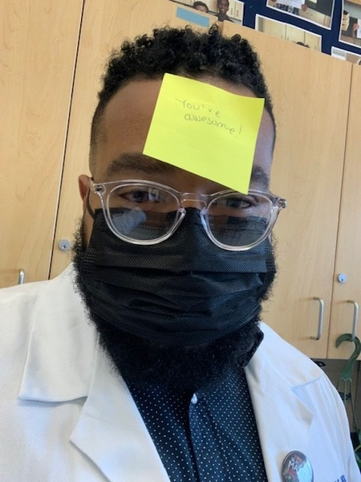
What Is A PA?
  Physician Associates/Physician Assistants
  are skilled members of the health care team
  practice medicine with a licensed physician
  fulfill a broad range of medical services otherwise provided by the physician

Slide 3
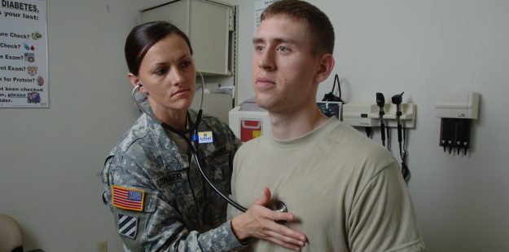


What Do PAs Do?
They conduct physical exams.
They diagnose and treat illnesses.
They write prescriptions.

Slide 4



What Do PAs Do?
They order and interpret medical tests.
They counsel on preventive health care.
They educate patients and their families.

Slide 5
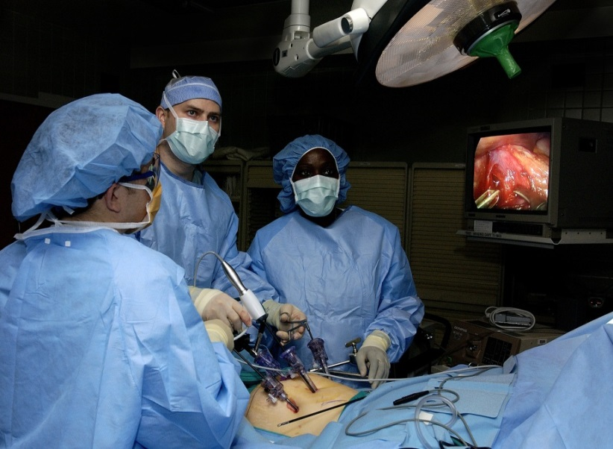
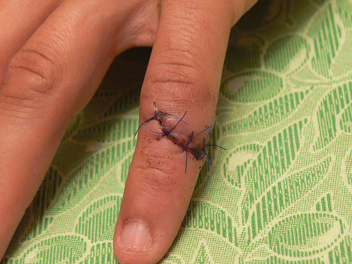

What Do PAs Do?
They assist in surgery.
They perform procedures.
They do rounds in hospitals.

Slide 6
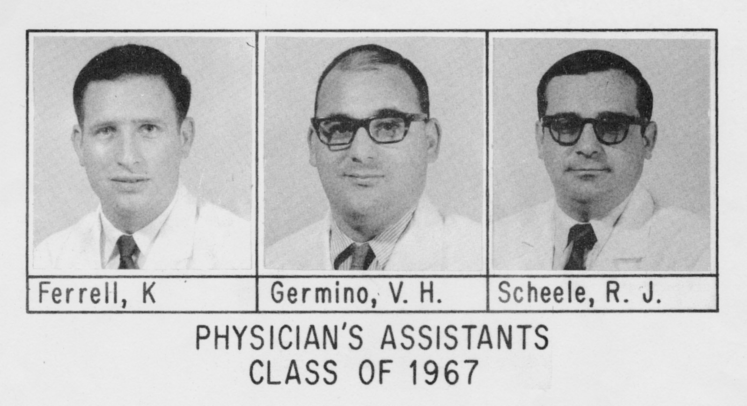
PA History
BIRTH OF PA PROFESSION
In the mid-1960s, physicians at Duke University Medical School recognized the need for a new type of health professional with comprehensive medical education to increase access to quality health care.
FIRST PA STUDENTS
Former military corpsmen seeking an
opportunity to use their medical skills in
civilian life
1967
The first three PAs graduated from Duke University.
Dr. Stead video: https://vimeo.com/90552709

Slide 7
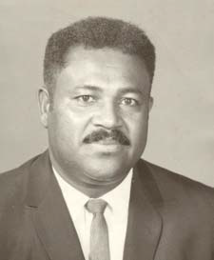
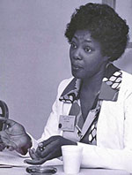
PA History
HENRY “BUDDY” TREADWELL
JOYCE NICHOLS,
PA-C
Precursor to physician assistant
Earned honorary PA certificate in 1970
Veteran and leader in community
Eugene Stead modeled the PA profession largely on the interactions noted between this man and his supervising MD
First woman formally educated as a PA
First African American woman to practice as a PA
Served on AAPA Board of Directors
Established the AAPA Minority Affairs Committee
Established one of the first rural health satellite clinics

Slide 8
PA Professionals in Today’s Economy
PA PROFESSION RANKS HIGH
U.S. News & World Report ranked the PA profession #2 in its 2022 Best Health Care Jobs and #3 in its 100 Best Jobs ranking.
Kiplinger’s named PA as one of its “great careers for your future.”
The U.S. Bureau of Labor Statistics projects that by 2030 the PA profession will grow 31%, much faster than the average growth rate of 8%

Slide 9


#5 Fastest Growing Job in America!
¹
$115,390
Median annual salary of PAs²
10/10
Job market score³
8/10
Work-life balance score³
²U.S. Bureau of Labor Statistics
³U.S. News & World Report

Slide 10
Top 7 PA Practice Specialties
Source: AAPA 2021 Salary Report

Slide 11
PA Income by Specialty
Source: AAPA 2021 Salary Report
Notes:
NEED TO UPDATE?

Slide 12
Top 5 PA Practice Settings
Source: Data from NCCPA 2020 Statistical Profile of Certified Physician Assistants
Notes:
NEED TO UPDATE?

Slide 13
Preparing for PA School
UNDERGRADUATE EDUCATION
  Select an appropriate major
  Research the necessary pre-requisites for PA programs
  Maintain a high GPA, especially in science courses
  Prepare for the GREs
PA PROGRAMS ARE GRADUATE PROGRAMS
  PA Program Directory – https://paeaonline.org/our-programs
  PAEA Website - https://paeaonline.org/how-we-can-help/advisors

Slide 14

Preparing for PA School
Most programs require coursework in:
Anatomy
Physiology
Biological Sciences
Chemistry
College Math
Computer Science
English

Slide 15
Tips for Educational Success
Read before class
Ask questions in class
Take organized notes
Attend class regularly
Don’t cram for tests
Ask teacher for study tips
Study in one-hour blocks
Test yourself
Sleep before exams
Breathe and relax during exams
Use time management
Use planners and prioritize
Find a mentor

Slide 16

Payment Programs
Loan repayment programs include:
  National Health Service Corps: A federal program for PAs who practice
  in primary care in underserved communities
    NHSC LRP
    NHSC Substance Use Disorder (SUD) Workforce LRP
    NHSC Rural Community LRP
    NHSC Students to Service LRP
  The U.S. Army: A three-year loan repayment program for serving as
  an Army PA
  AmeriCorps: Helps pay for education loans in
  exchange for a year of service in designated areas
  across the United States
  Indian Health Service (IHS): A national program with
  the goal of placing health care professionals, including
  PAs, in IHS health centers for a minimum of two years

Slide 17

PAs Are People Like You
* Or Watch Here

Slide 18

PA Job Satisfaction
Would you become a PA if you had to do it all over again?
82%
of respondents said “Yes”
51%
strongly agreed that they would do it again
CONTRIBUTORS
TO JOB SATISFACTION
Being able to practice medicine
Growth in scope of
practice over time
Ability to change
specialties and/or
work settings
relatively easily
Balance of
work-life
Source: 2017 AAPA Salary Survey (unpublished data)

Slide 19
Connect with PAEA
Ask us your questions! – students@PAEAonline.org
  Get info on the PA profession, Project Access, admissions, CASPA, paying for PA school, and more.
PAEA Program Directory – https://paeaonline.org/our-programs
  Search PA programs for admission requirements, location, tuition, and much more.
Pre-PA & Advisor Webpage - https://paeaonline.org/how-we-can-help/advisors

Slide 20
Local PA Programs
Enter your information here.

Slide 21
Learn More
PHYSICIAN ASSISTANT EDUCATION ASSOCIATION
655 K Street NW
Suite 700
Washington, DC 20001
www.PAEAonline.org
projectaccess@PAEAonline.org
PA Focus Social Media
Pre-PA and PA student focused informational accounts
Facebook: @PAFocus
Instagram: @pa_focus
Twitter: @pa_focus
AMERICAN ACADEMY OF PHYSICIAN ASSOCIATES
2318 Mill Road
Alexandria, VA 22332
https://www.aapa.org/
https://www.aapa.org/about/dei-resource-center/

